Slide 1
What do you fear (Isaiah 7)?
Preached by Dr. Jim Harmeling at Crossroads International Church Singapore • cicfamily.com Uploaded by Dr. Rick Griffith • Singapore Bible College Files in many languages for free download at BibleStudyDownloads.org

Slide 2
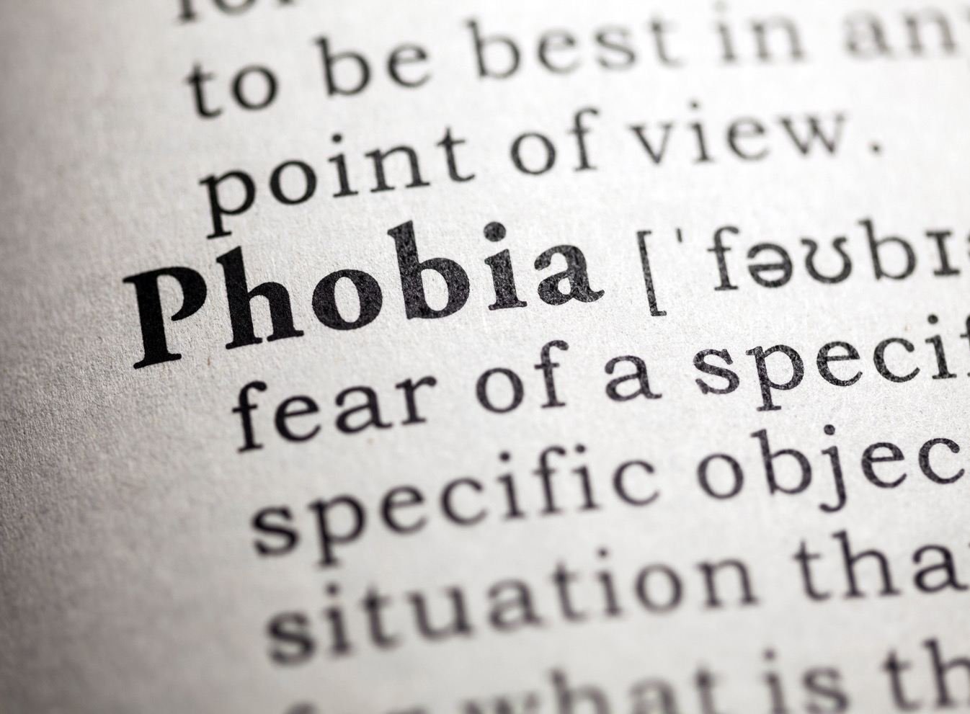

Slide 3
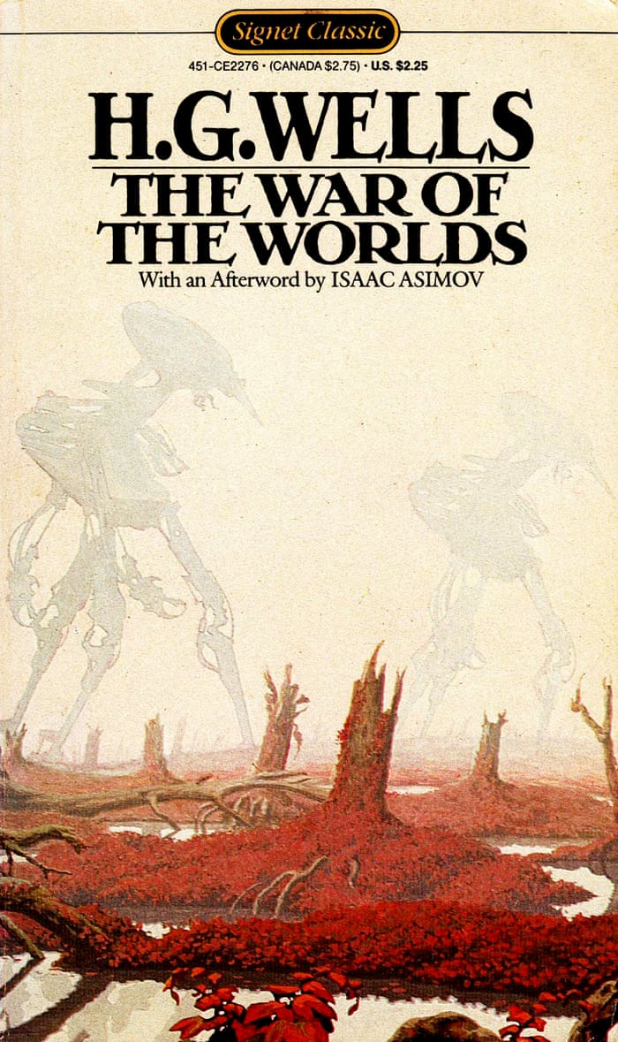
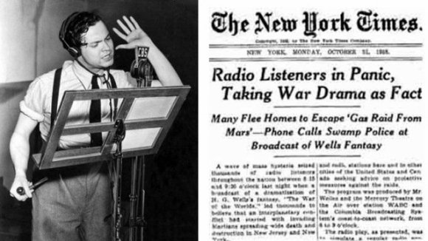

Slide 4
Who do you trust?
Obeying the voice of God in crisis
H i g h l i g h t s f r o m t h e p r o p h e t I s a i a h

Slide 5
Who do you trust when you’re afraid?
Resist temptation to trust in human power (vs. 1-2)
Isaiah 7

Slide 6
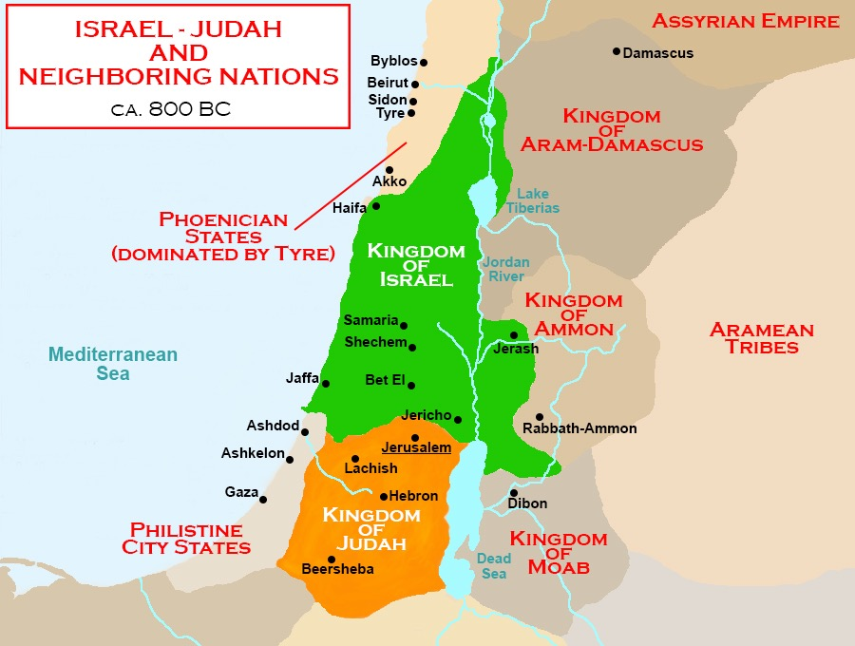

Slide 7
2 Chronicles 28:6, 8
⁶ For Pekah the son of Remaliah killed 120,000 from Judah in one day, all of them men of valor, because they had forsaken the Lord, the God of their fathers. . . ⁸ The men of Israel took captive 200,000 of their relatives, women, sons, and daughters. They also took much spoil from them and brought the spoil to Samaria.

Slide 8
Follow the Lord by trusting in His words of assurance (vs. 3-9)
Words of direction

Slide 9
Stop
Be Quiet
Calm Down
Be Resolved

Slide 10
Follow the Lord by trusting in His words of assurance (vs. 3-9)
Words of direction
“An agitated spirit does not comport with true faith; when one rests upon the Lord, there is no need to fear what man will do. Faith involves calmness and serenity.”
E. J. Young

Slide 11
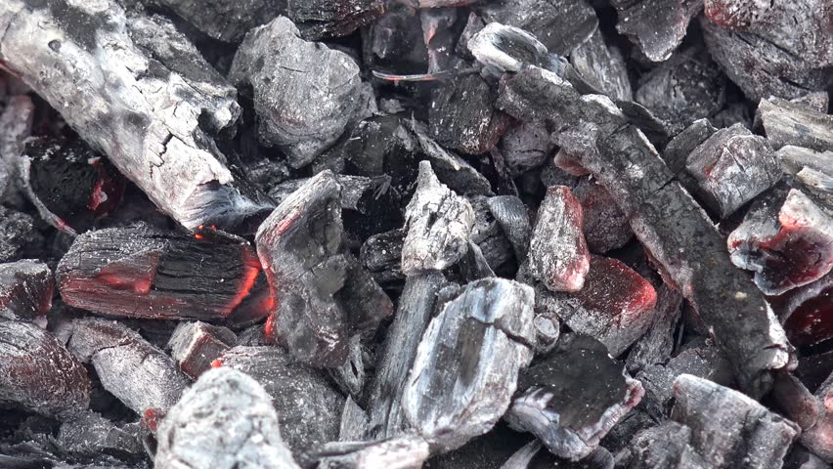
Follow the Lord by trusting in His words of assurance (vs. 3-9)
Words of direction
Words of perspective
Pekah
Rezin

Slide 12
Follow the Lord by trusting in His words of assurance (vs. 3-9)
Follow the Lord by trusting in His sovereign power (vs. 10-25)

Slide 13
²² All this took place to fulfill what the Lord had spoken by the prophet:
²³ “Behold, the virgin shall conceive and bear a son, and they shall call his name Immanuel”
(which means, God with us).

Slide 14
Isaiah 7:14
A sign is given to Ahaz/Israel
The sign is a child
The sign proves God’s presence to provide physical deliverance
Ahaz in crisis
rejects God’s plan
God and the sign are rejected by Israel and they suffer defeat
Matthew 1:22-23
A sign is given to Israel
The sign is a woman
The sign proves God’s presence to provide spiritual deliverance
Joseph in crisis
accepts God’s plan
God and the sign are rejected by man and they suffer damnation

Slide 15
Black

Slide 16
OT Preaching link at BibleStudyDownloads.org
Get this presentation for free!
Notes:
OT Preaching (op)

